Slide 1
Deep Learning Final Project:
G16 - Balls detection team
Artem Lykov, Engineering Systems, Ms-1
Anna Ilushina, Engineering Systems, Ms-1
Artem Bazhenov, Engineering Systems, Ms-1
Vladimir Berman, Engineering Systems, Ms-1
Professor:‪Ivan Oseledets
GitHub: https://github.com/aliudvidere/Cherries_detection.git

Slide 2
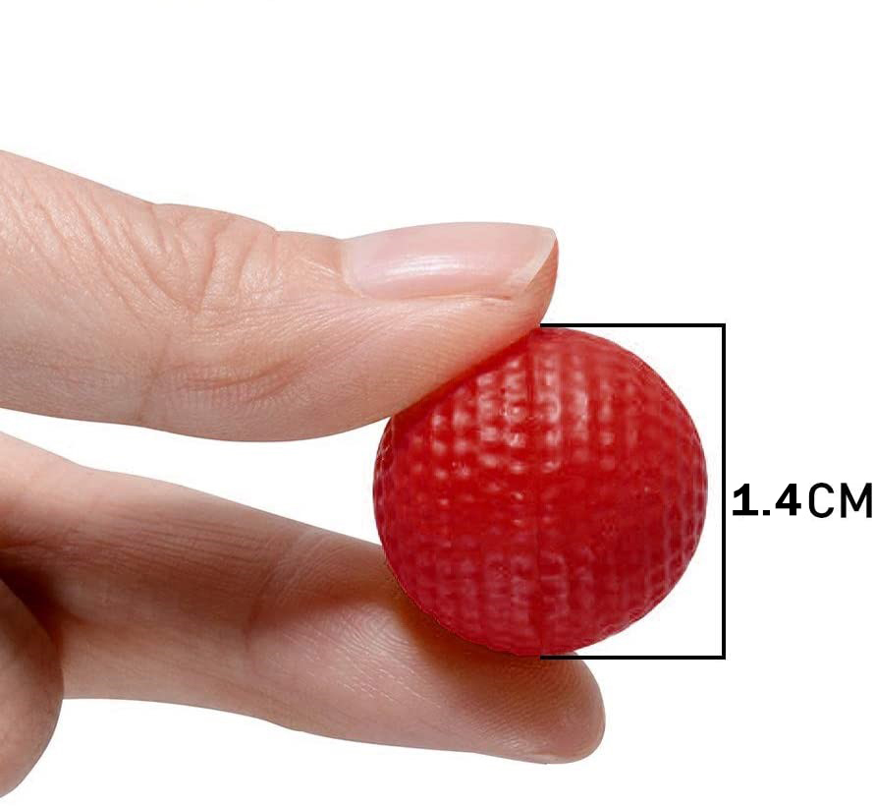
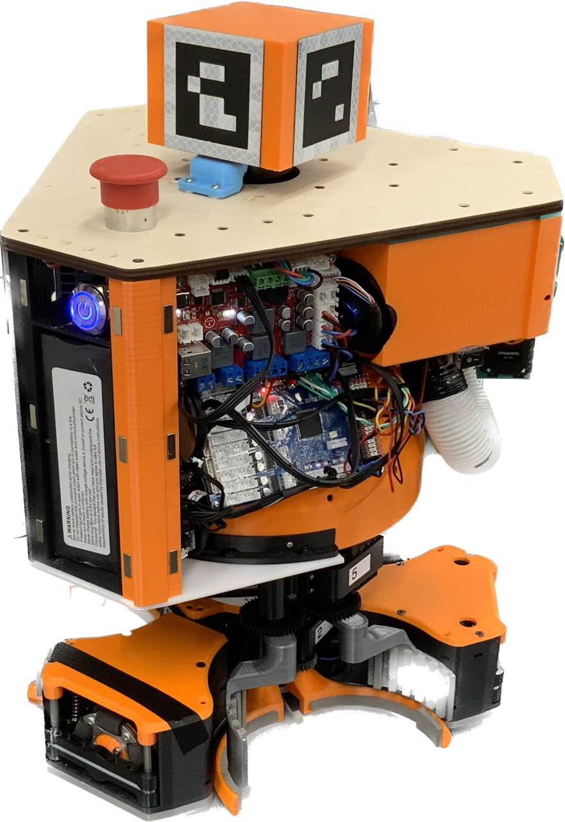
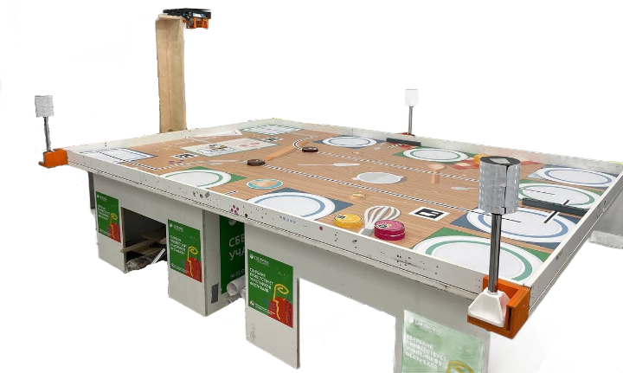
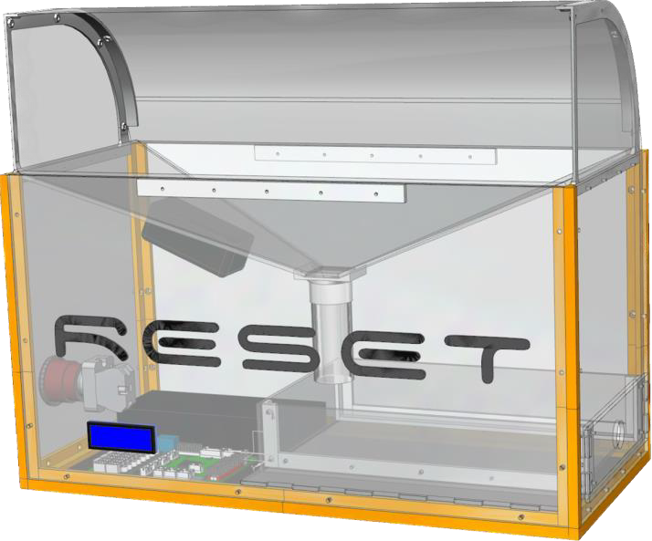
Project overview
Object for detection (Cherry)
Competition robot
Game environment
2
Cherry box

Slide 3
Project goals
For counting red balls (cherries) do the following:
Implement classic CV algorithms (Edge detection);
Implement classic CV algorithms (Hough Transform);
Implement CNNs (Faster R-CNN);
Implement CNNs (Yolo v8);
Compare results.
3

Slide 4
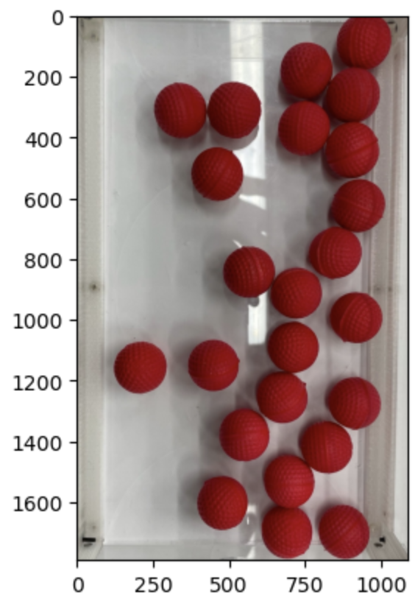
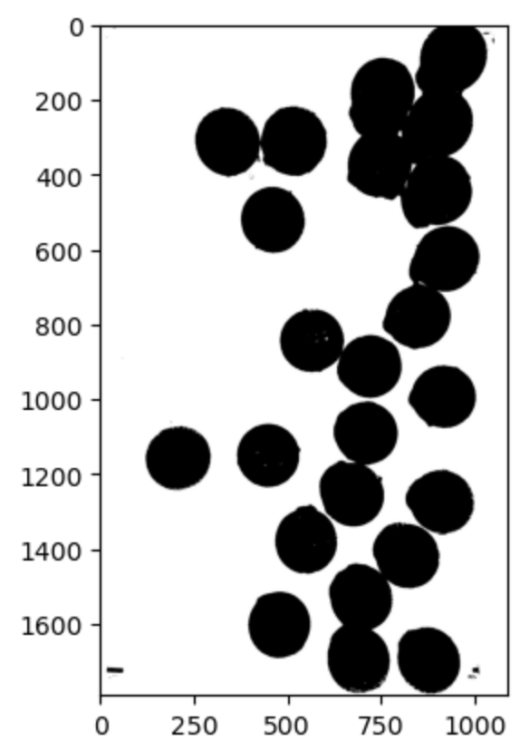
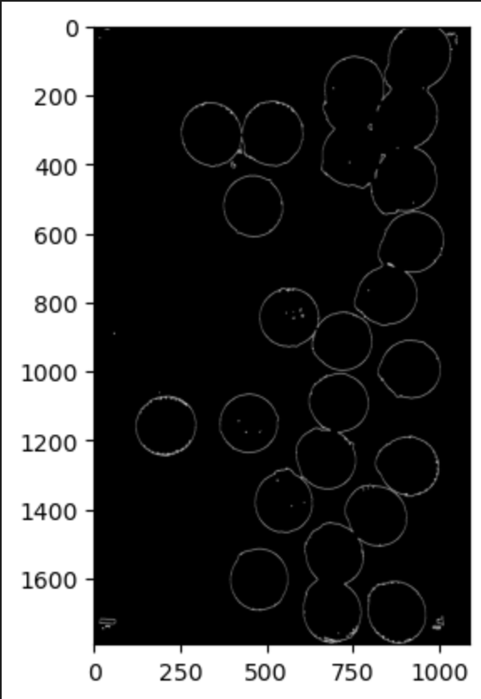
Edge detection
This method does not work properly
4

Slide 5
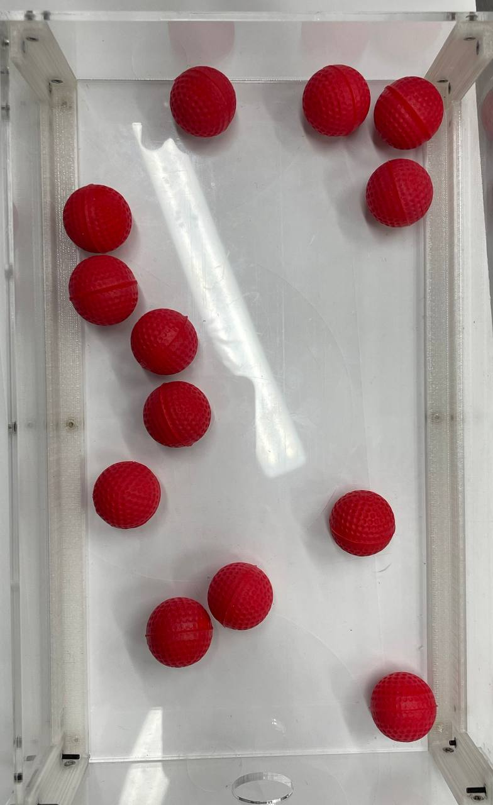

Hough Transform
This algorithm works correct, but only with fixed
size of ball and certain position of the camera. In this case we cannot use this approach.
5

Slide 6
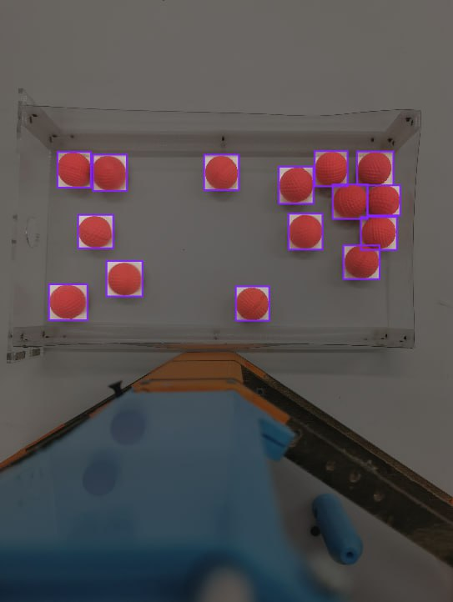
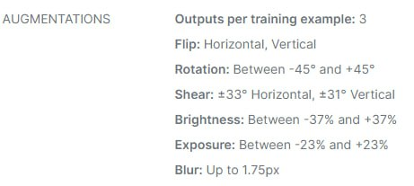
Dataset
"boxes": [
{
"label": "Ball",
"x": "445.50",
"y": "1018.11",
"width": "199.92",
"height": "214.73"
},
{
"label": "Ball",
"x": "658.99",
"y": "1036.62",
"width": "202.39",
"height": "217.20"
},
{
"label": "Ball",
"x": "1327.86",
"y": "1034.15",
"width": "207.32",
"height": "212.26"
} …
For networks trainings we use custom dataset, which was annotated using Roboflow.
6

Slide 7
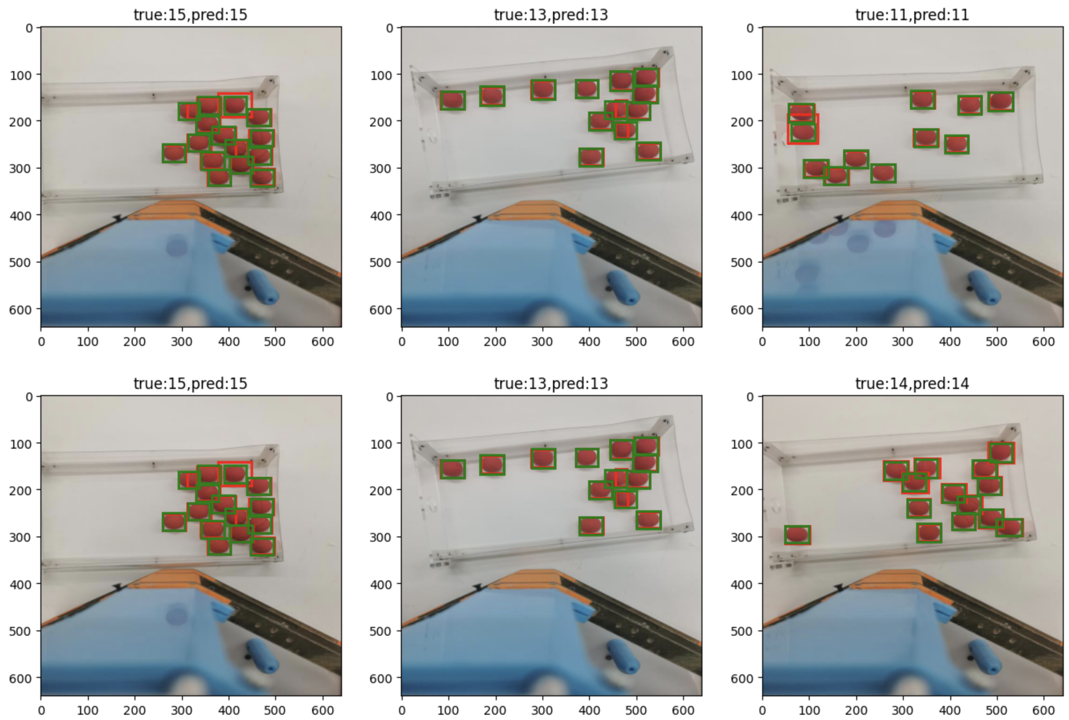
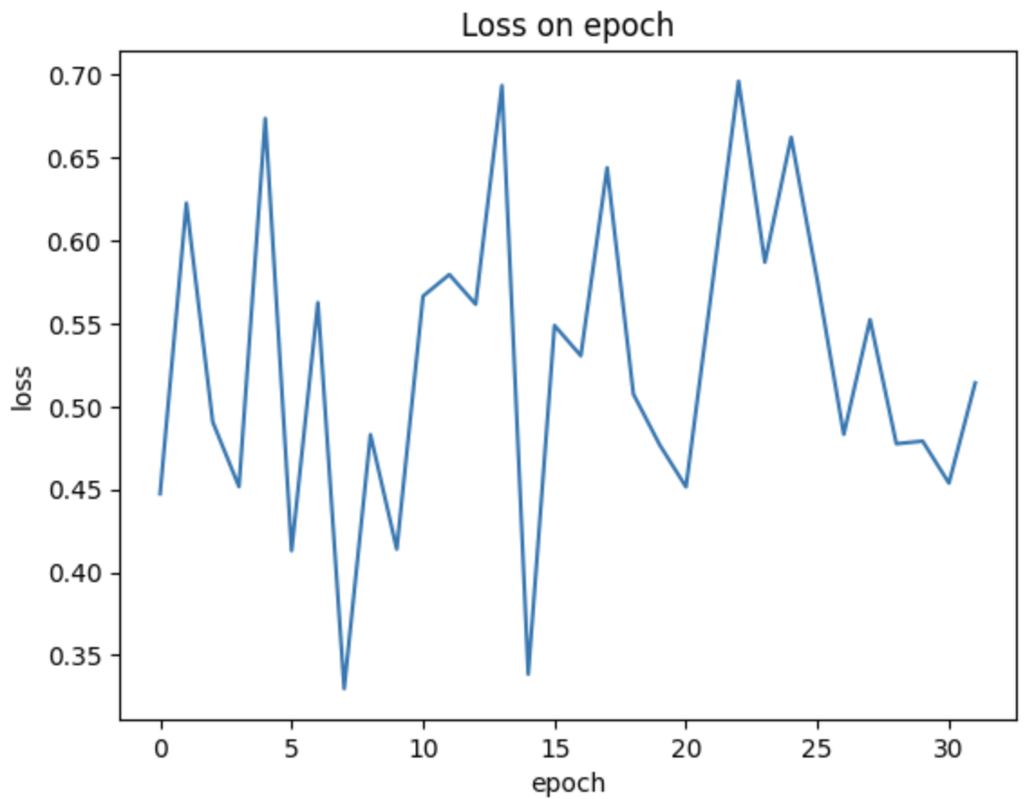
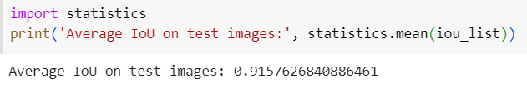
Faster R-CNN
7

Slide 8
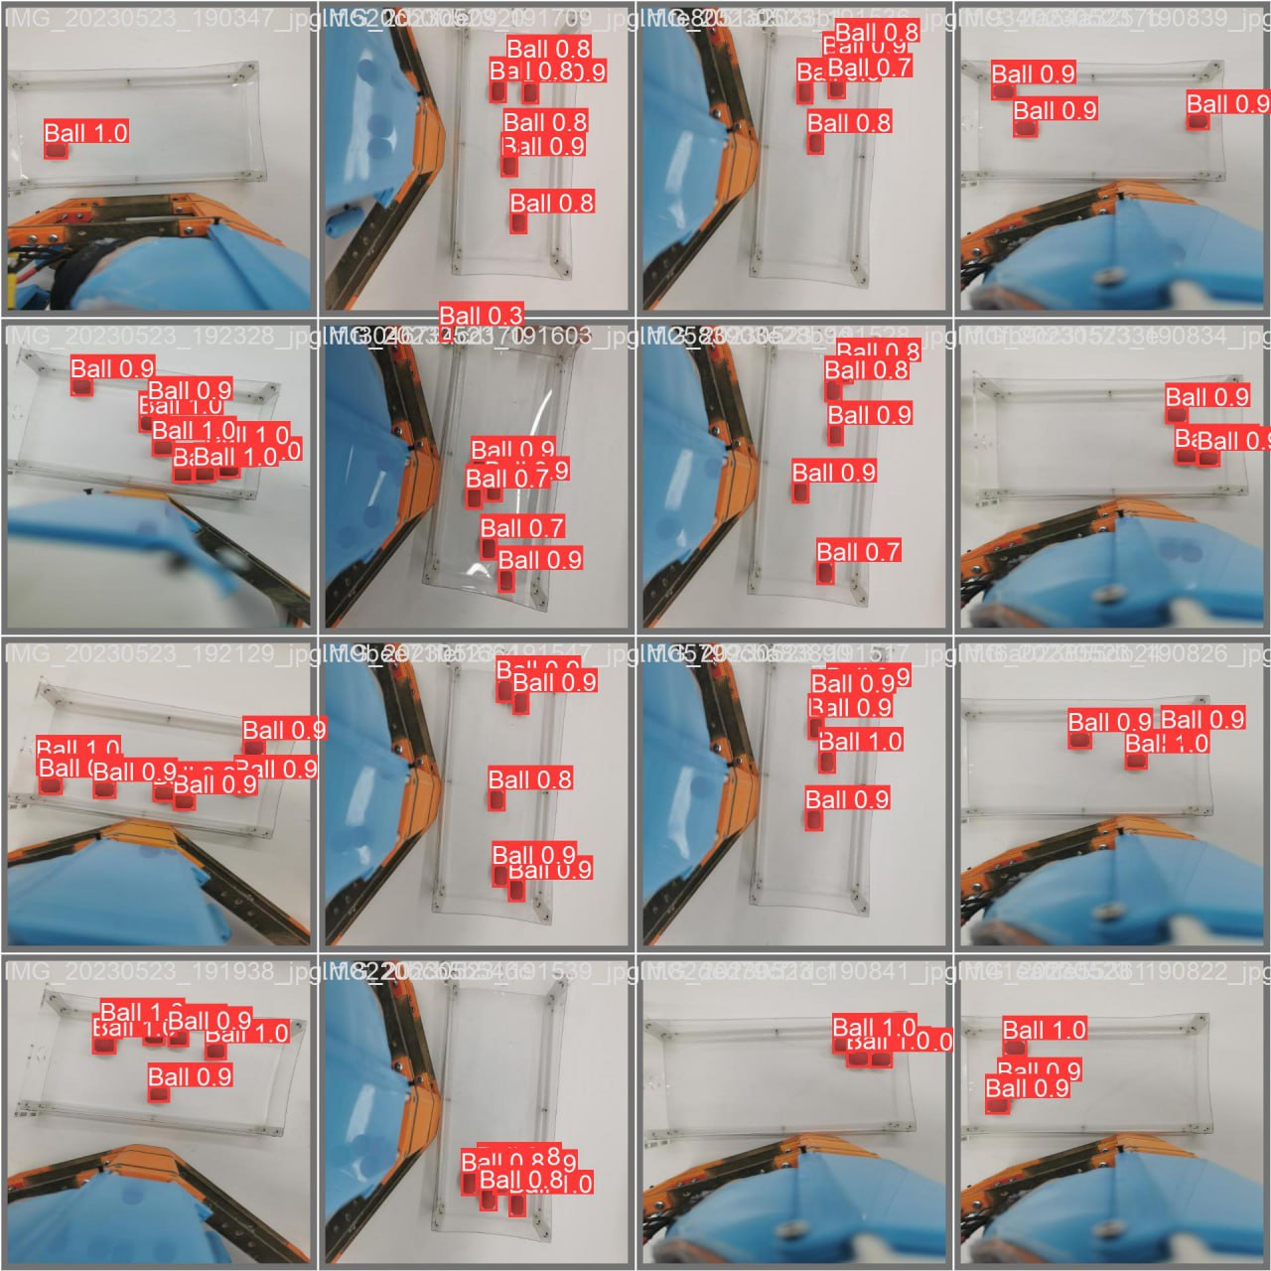
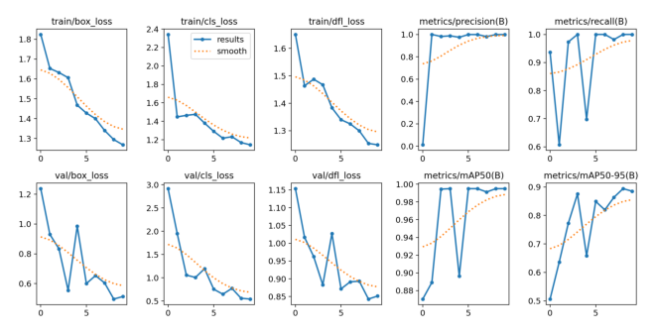
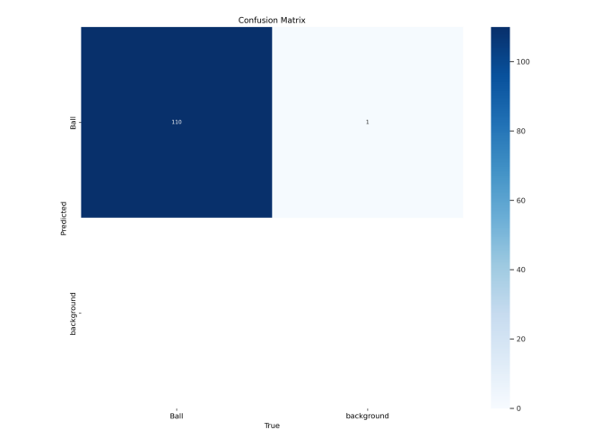
YOLO v8
8

Slide 9
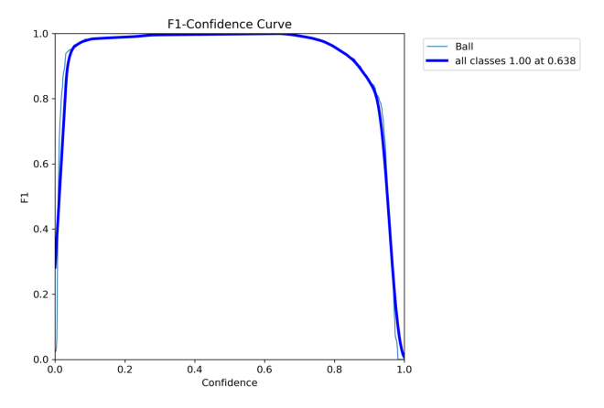
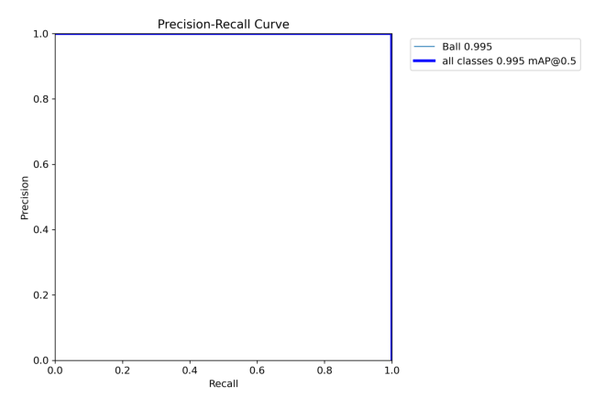
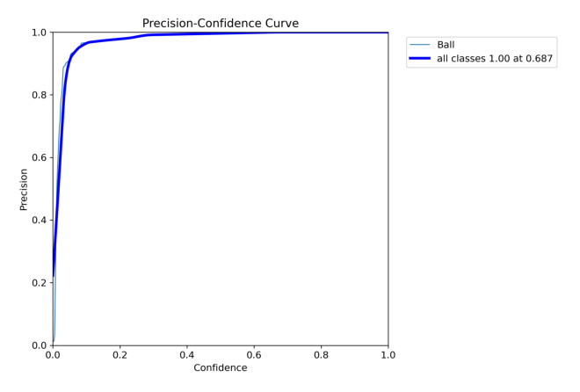
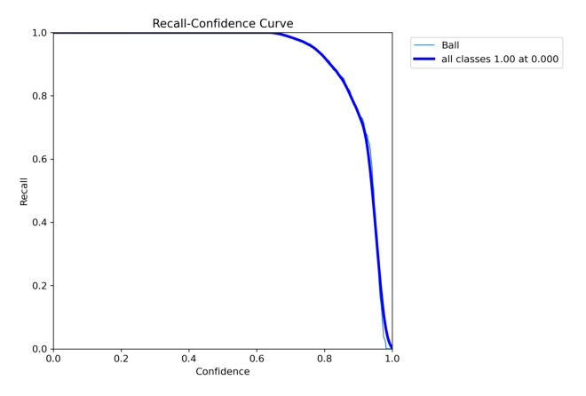
YOLO v8 (metrics)
9

Slide 10
Results
Compare all approaches we decided use YOLO v8 due to:
It works properly;
It is faster then Faster R-CNN;
It can work on week hardware like Raspberry Pi4;
Earlier we planed using electronics for counting cherries, but CV show, that we can do this without vibromotors and complex mechanics.
10

